Slide 1

Search Engine
School of Engineering and Technology
Submitted By:
Anubhav Ranjan (CSE)
Nitin Kumar Vasdhani (CSE)
Jaimala Prajapati (CSE)
Submitted To :
Assistant Professor Mr. Surendra Mehra

Slide 2
Contents
Introduction
Problem of Statement
Work Flow
Flow Chart
User Interaction
Technologies Used
Applications
Conclusion

Slide 3
Introduction
A search engine is a software program that helps people find the information they are looking for online using keywords or phrases.
Companies use Search Engine Optimization (SEO) to help search engines recognize their websites as highly relevant to particular searches.
A search engine is a web-based tool that enables users to locate information on the World Wide Web. Popular examples of search engines are Google, Yahoo! And Bing.

Slide 4
Problem of Statements
Which Systems to Use and Why ?
To be Used : Hybrid System
It is the System that provides the more functionality, User Interaction and Content for better experience of User.
As it Provide both functionalities of SEARCH CONTENT BASED filtering.

Slide 5
Work Flow
User
Interface
General Interface
Sign Up
Reset
Forget
Login
Display
Fetch
Use API
Home
Contact us
About us

Slide 6
Flow Chart
START
Asking
= ?
No
Sign Up Page
Yes
Confirm
Ok
Registered
Login Page
Main Page
Result Page
END
(Where you can search anything)
(Where your data searched result shows)

Slide 7
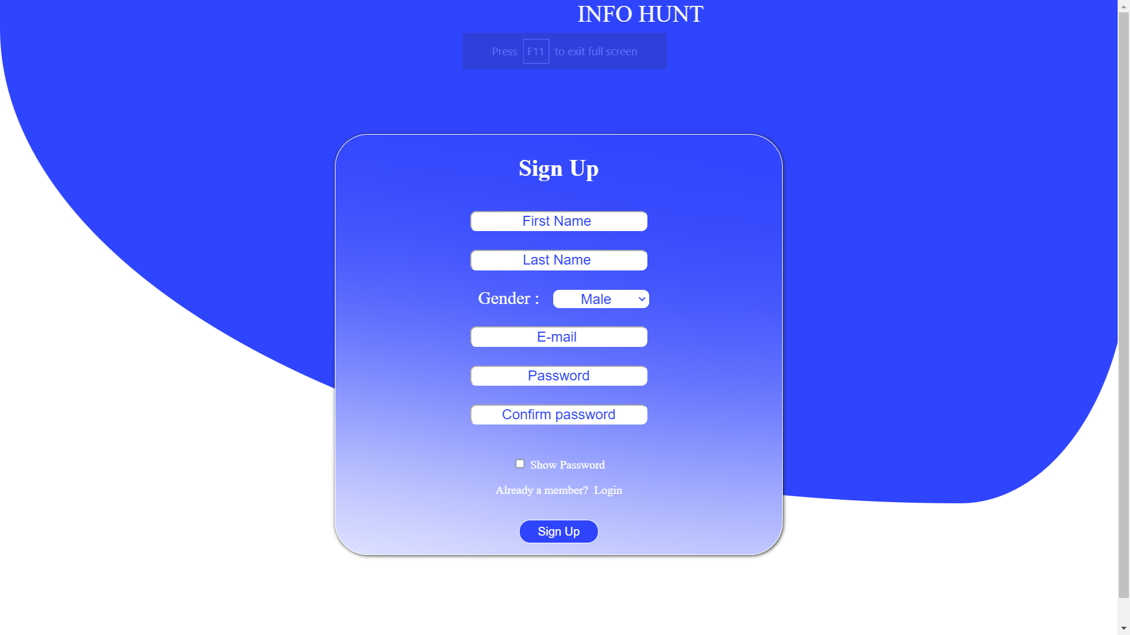
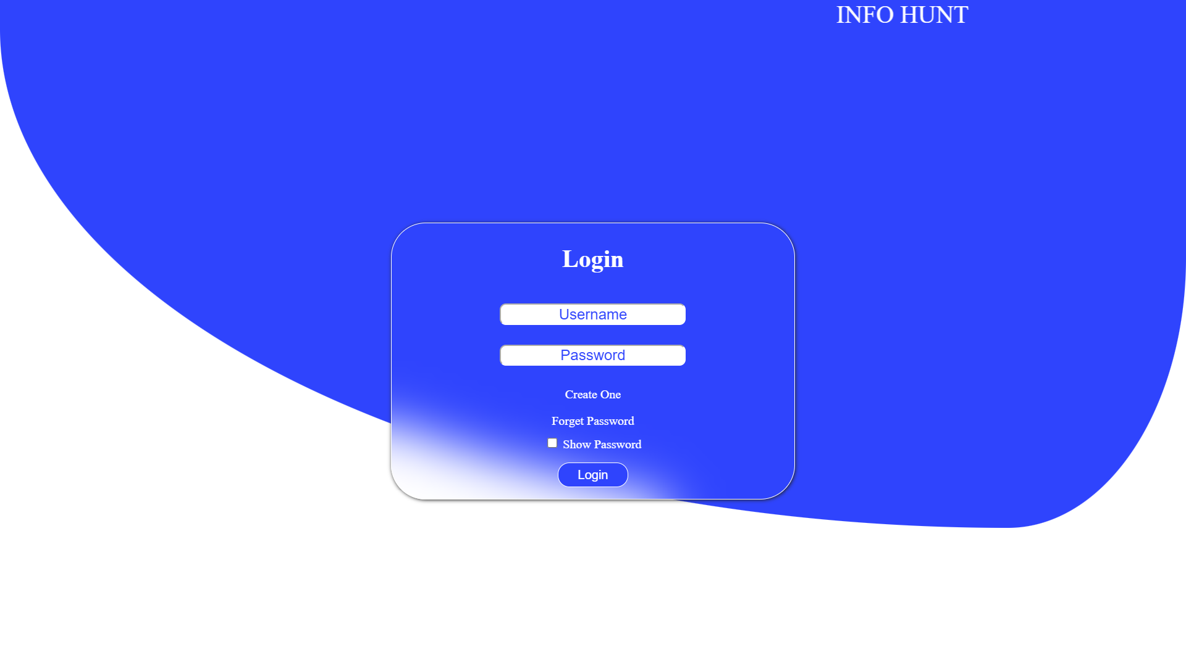
User Interaction
1. Sign Up
2. Login

Slide 8
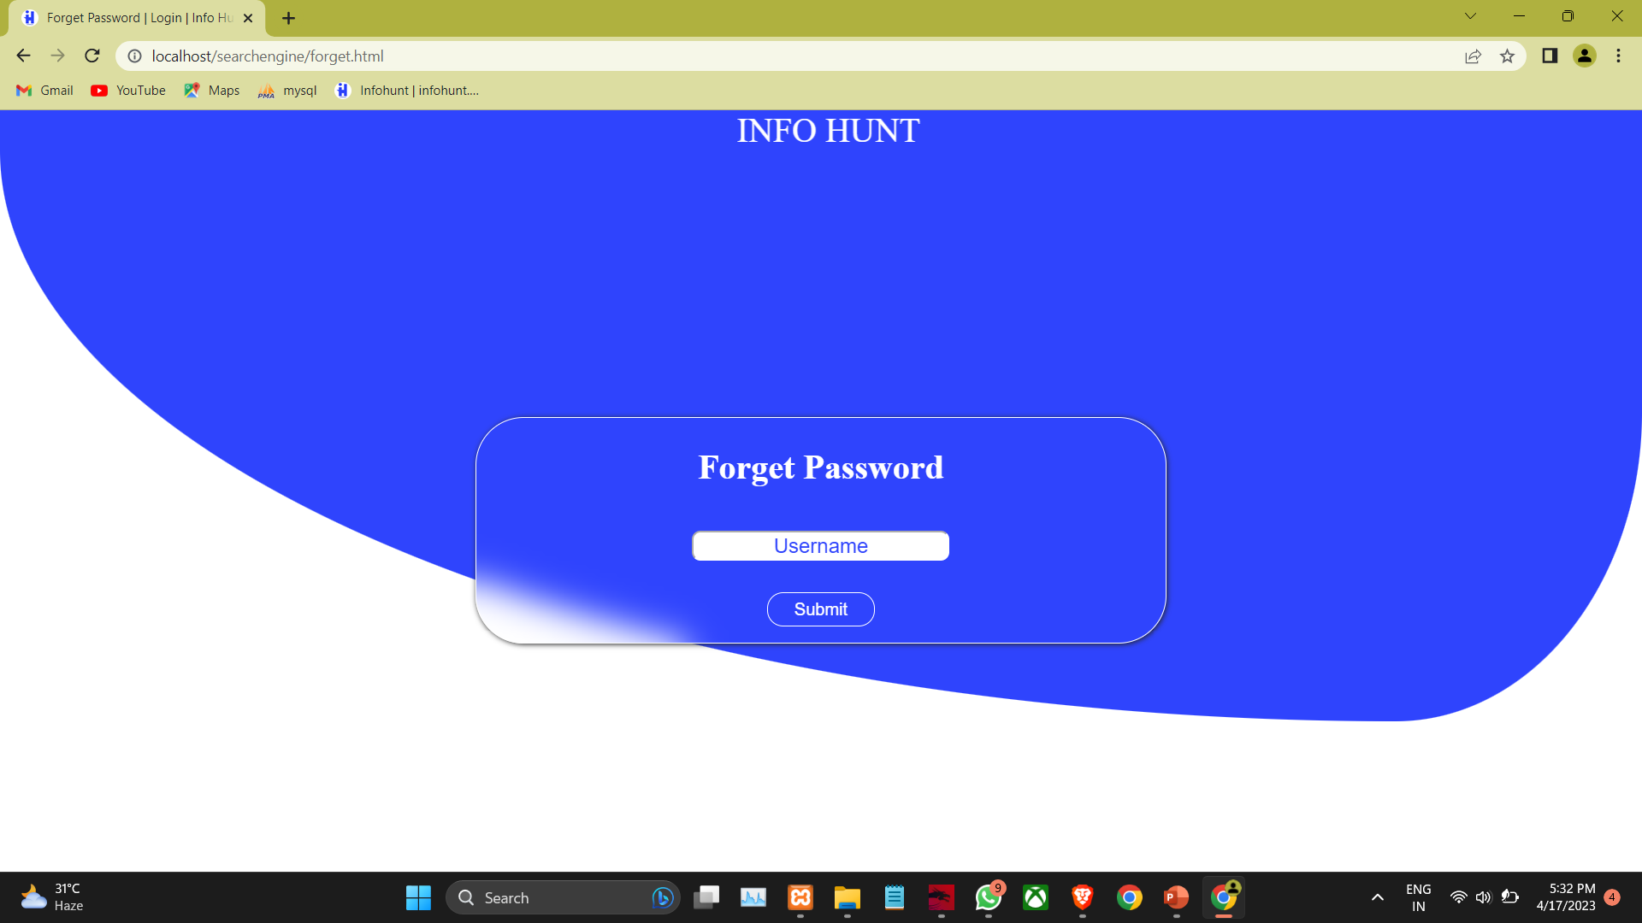
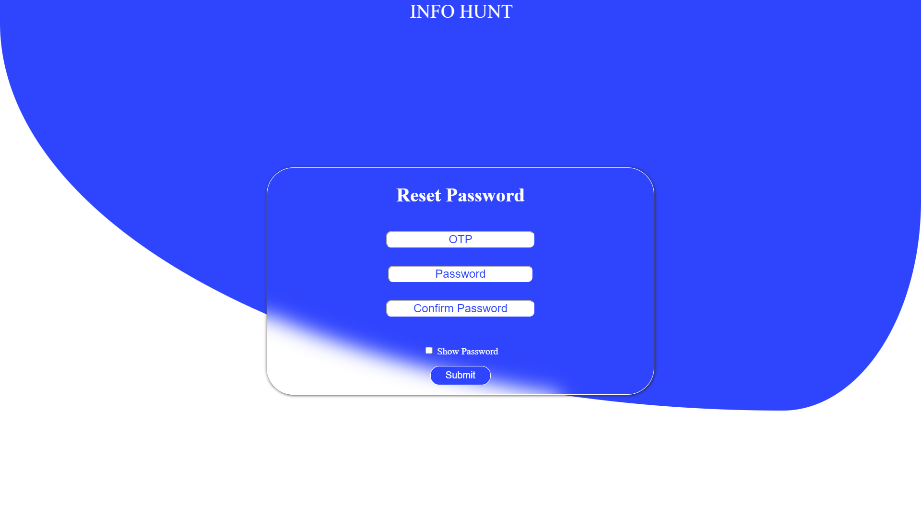
User Interaction
3. Forget Password
4. Reset Password

Slide 9
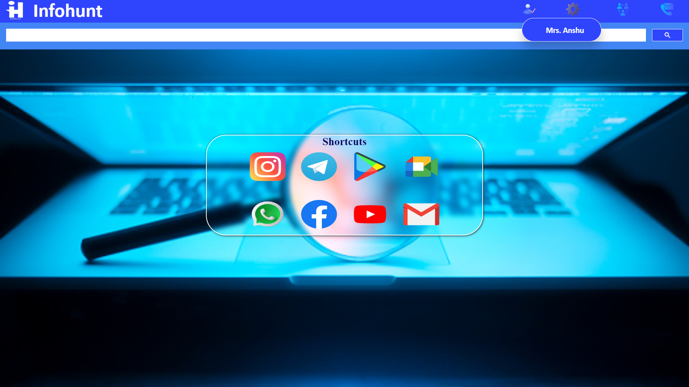
User Interaction
Setting
About us
Username
Contact us
Shortcut icon section
5. Main Interface

Slide 10
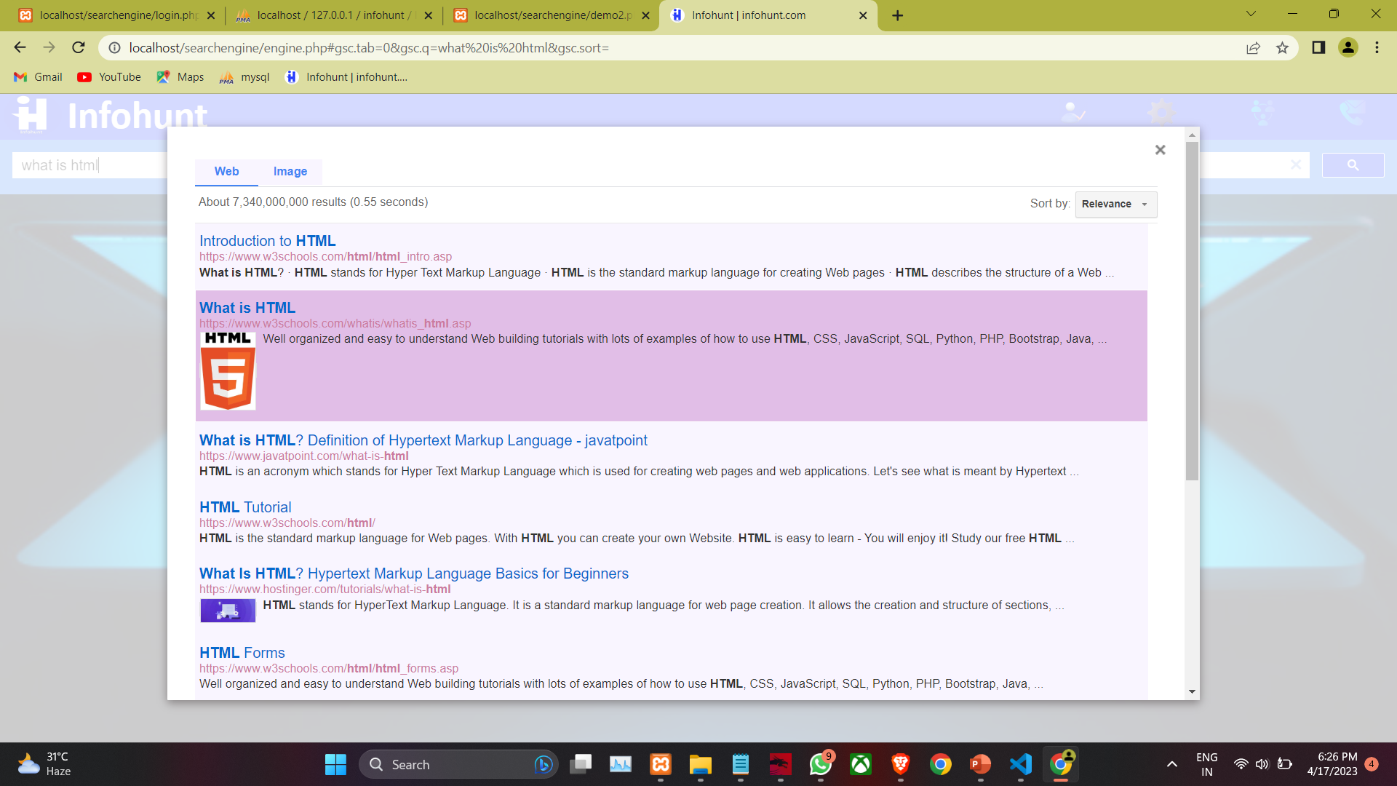
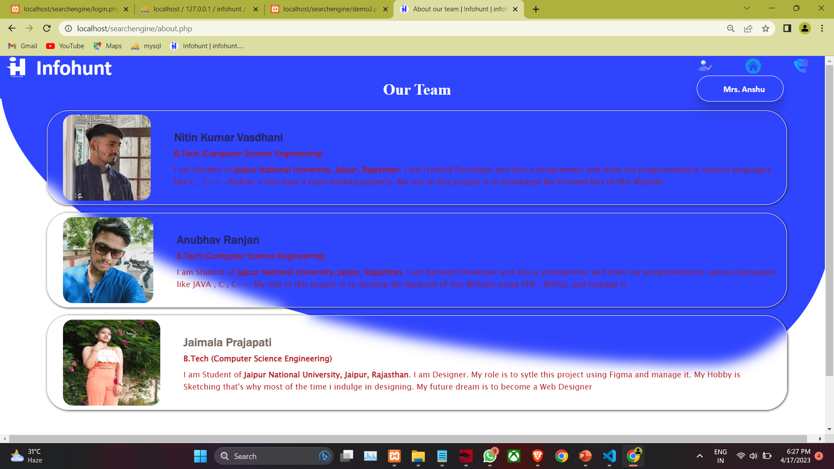
User Interaction
6. Result
7. About Us

Slide 11


Technologies Used
Front –End Development
HTML/HTML5
HTML stands for Hyper Text Markup Language. HTML is the standard markup language for creating Web pages. HTML describes the structure of a Web page. HTML consists of a series of elements. HTML elements tell the browser how to display the content.
CSS
CSS stands for Cascading Style Sheets. CSS describes how HTML elements are to be displayed on screen, paper, or in other media. CSS saves a lot of work. It can control the layout of multiple web pages all at once

Slide 12


Technologies Used
Javascript
JavaScript (js) is a light-weight object-oriented programming language which is used by several websites for scripting the webpages. It is an interpreted, full-fledged programming language that enables dynamic interactivity on websites when applied to an HTML document.
BootStrap
Bootstrap is a free and open-source tool collection for creating responsive websites and web applications. It is the most popular HTML, CSS, and JavaScript framework for developing responsive, mobile-first websites. It solves many problems which we had once, one of which is the cross-browser compatibility issue.

Slide 13


Technologies Used
Back-End Development
PHP
PHP stands for Hpyertext Preprocessor. PHP is a widely-used, open source scripting language. PHP scripts are executed on the server. PHP files can contain text, HTML, CSS, JavaScript, and PHP code. PHP code is executed on the server, and the result is returned to the browser as plain HTML.
DataBase Management
MYSQL
MySQL is a relational database management system. MySQL is open-source. MySQL is cross-platform. MySQL is developed, distributed, and supported by Oracle Corporation
MySQL is ideal for both small and large applications.

Slide 14


Technologies Used
Server
XAMPP
XAMPP full form is X-operating system, Apache, Mysql, Php, Perl. One of the main features
of XAMPP is that it is the simplest and lightest local server. XAMPP is an open-source platform. It works on all major operating systems like Windows, Mac, Linux, etc. When a server is hosted locally on your computer, it is called a local server. These local servers help developers test a website several times before making it available on the Internet.
Editor
Vs code
Visual Studio Code is a streamlined code editor with support for development operations like debugging, task running, and version control. It aims to provide just the tools a developer needs for a quick code-build-debug cycle and leaves more complex workflows to fuller featured IDEs, such as Visual Studio IDE.

Slide 15

Technologies Used
Browser
Chrome
Google Chrome browser is a free web browser used for accessing the internet and running web-based applications. The Google Chrome browser is based on the open source Chromium web browser project.

Slide 16
Applications
Enhanced User Experience.
More time spend on the platform
Personalize a platform and help users find what the looking for.
He higher their engagement and as a result increased revenue.
Increased loyalty and share of mind.
Examples
Google
Bing !
Yahoo
DuckDuckGo
YouTube

Slide 17
Conclusion
Search Engine is designed for getting relevant results.
The primary goal is to provide high quality search results over a rapidly growing World Wide Web e.g. Google employs a number of techniques to improve search quality including
page rank, anchor text, and proximity information. Furthermore, Google is a complete architecture for gathering web pages, indexing them, and performing search queries over them.

Slide 18

Thank You !

